Slide 1
Lecture 8 & 9
CS404: Software Engineering
Software Requirement Specification and Analysis
Software Engineering: A Practitioner’s Approach, 7/e
by Roger S. Pressman
Slides copyright © 1996, 2001, 2005, 2009 by Roger S. Pressman
Software Engineering 9/e
By Ian Sommerville

Slide 2
Contents
Class Based Models
General Classification
Coad and Yourdon’s Six Selection Criteria
Noun-Verb Affiliation of Classes
Class Attributes and Class Methods
UML Class Diagrams

Slide 3
General Classification
External Entities (e.g., other systems, devices, people) that produce or consume information to be used by a computer-based system.
Things (e.g., reports, displays, letters, signals) that are part of the information domain for the problem.
Occurrence or events (e.g., a property transfer or the completion of a series of robot movements) that occur within the context of system operation.
Roles (e.g., manager, engineer, salesperson) played by people who interact with the system.
Organizational units (e.g., division, group, team) that are relevant to an application.
Places (e.g., manufacturing floor or loading dock) that establish the context of the problem and the overall function of the system.
Structure (e.g., sensors, four-wheeled vehicles, or computers) that define a class of objects or related classes of objects.
No. | Noun/Noun Phrases | General Classification | Remarks
1 | Registration Application | 2 | ✓
2 | General Member | 4,7 | ✓
3 | Name
4 | Phone Number
5 | Member wise Report | 2,7 | ✓

Slide 4
Contents
Class Based Models
General Classification
Coad and Yourdon’s Six Selection Criteria
Noun-Verb Affiliation of Classes
Class Attributes and Class Methods
UML Class Diagrams

Slide 5
Coad and Yourdon’s Six Selection Criteria
Retained Information: Will the system need to remember information about this class of objects?
Needed Services: Do objects in this class have identifiable operations that change the values of their attributes?
Multiple Attributes: If the class only has one attribute, it may be better represented as an attribute of another class.
Common Attributes: Does the class have attributes that are shared with all instances of its objects?
Common Operations: Does the class have operations that are shared with all instances of its objects?
Essential Requirements: External entities that produce or consume information essential to the system should be included as classes.
No. | Potential Classes | Selection Criteria | Remarks
1 | Registration Application | 1,3,4,5 | ✓
2 | General Member | 1,2,3,4,5 | ✓
3 | Member wise Report | 3,4

Slide 6
Contents
Class Based Models
General Classification
Coad and Yourdon’s Six Selection Criteria
Noun-Verb Affiliation of Classes
Class Attributes and Class Methods
UML Class Diagrams

Slide 7
Noun-Verb Affiliation of Classes
Find all the nouns and verbs from the usage scenario
For each class selected after Coad and Yourdon’s Six Selection Criteria determine which nouns and verbs have affiliation with the class
Prepare a table like the one on the right
No. | Selected Class | Noun | Verb
1 | General Member | Name Father’s Name Mother’s Name Phone Number Permanent Address Present Address Email Member ID Monthly fees Total fees | Change password Store Retrieve Update info Log out Rent Book Pay fees

Slide 8
Contents
Class Based Models
General Classification
Coad and Yourdon’s Six Selection Criteria
Noun-Verb Affiliation of Classes
Class Attributes and Class Methods
UML Class Diagrams

Slide 9
Class Attributes and Class Methods
Conduct further analysis on the affiliated nouns and verbs of each class determine which of them will be used as properties and methods
Also determine if you can merge some classes into one or a hierarchy
Prepare a table like the one on the right
No. | Final Class | Attributes | Methods
1 | GeneralMember | name fatherName motherName phoneNumber permanentAddress presentAddress email memberID monthlyFee totalFee | changePassword() logout() login() updateInfo() retrieveInfo () searchBook() rentBook() viewMonthlyFee() viewTotalFee() payFee()

Slide 10
Contents
Class Based Models
General Classification
Coad and Yourdon’s Six Selection Criteria
Noun-Verb Affiliation of Classes
Class Attributes and Class Methods
UML Class Diagrams

Slide 11
UML Class Diagrams
Draw the UML Class Diagram from the table prepared in the previous step

Slide 12
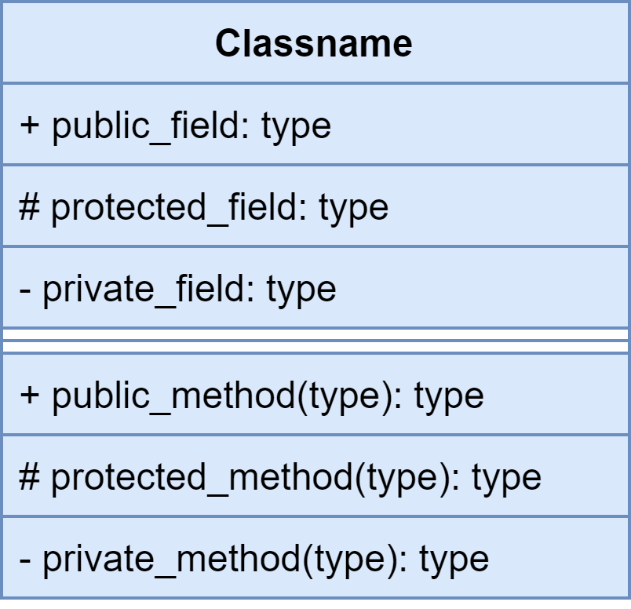
UML Class Diagrams Notations
Class Notation

Slide 13
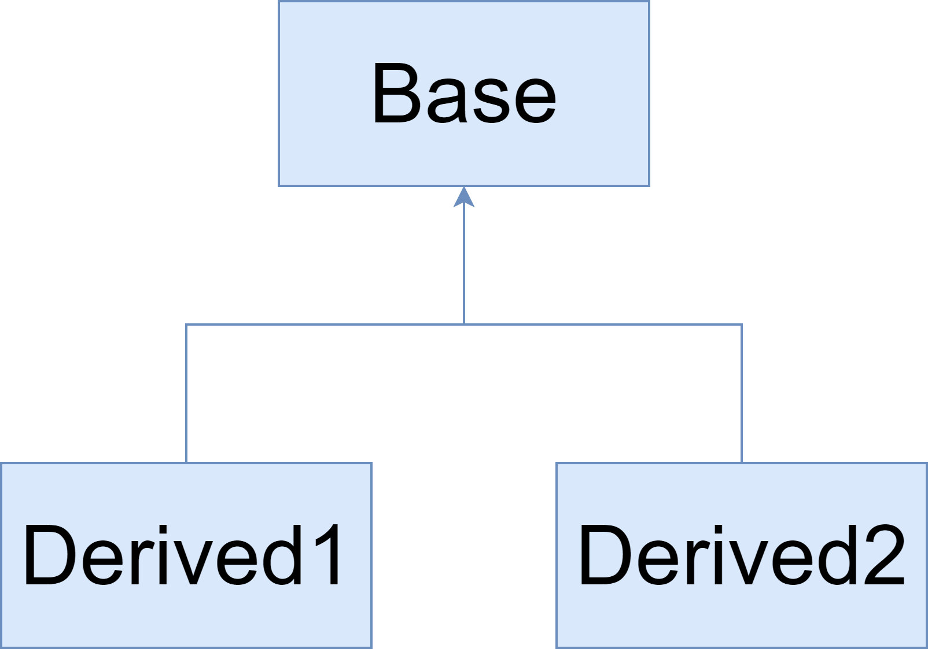
UML Class Diagrams Notations
Inheritence (is-a) Relationship

Slide 14
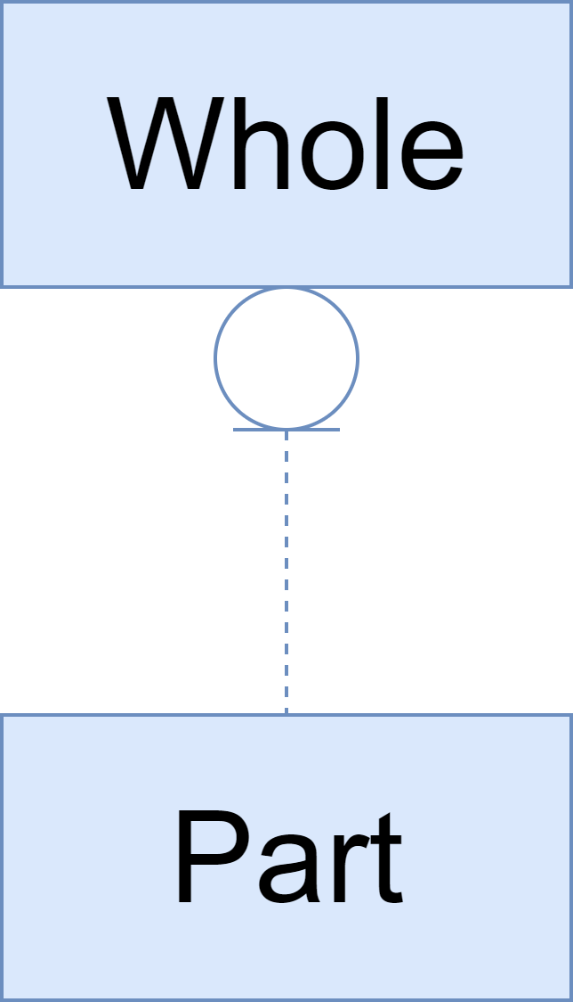
UML Class Diagrams Notations
Aggregation (has-a) Relationship
Whole has Part as a part
Lifetimes might be different
Part might be shared with other Wholes.

Slide 15
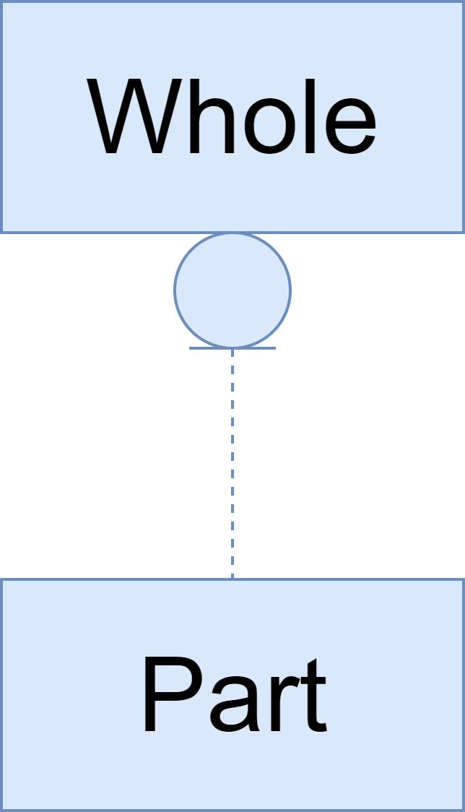
UML Class Diagrams Notations
Composition (has-a) Relationship
Whole has Part as a part
Lifetime of Part controlled by Whole
Part objects are contained in one Whole object

Slide 16
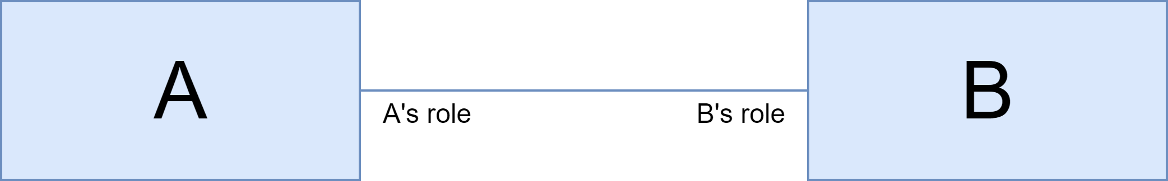
UML Class Diagrams Notations
Association (uses, interacts-with) Relationship

Slide 17
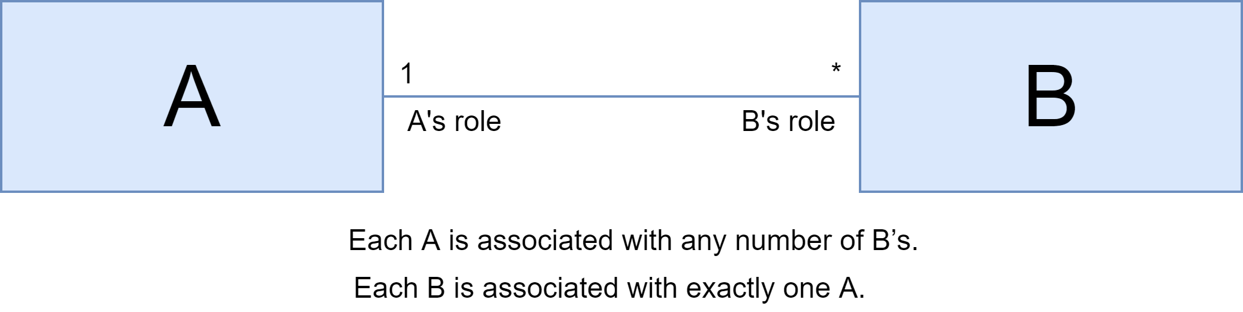
UML Class Diagrams Notations
Multiplicity in Aggregation, Composition, or Association
* - any number
1 – exactly 1
n – exactly n
0..1 – Zero or one
1..* - 1 or more
Follow line from start class to end class
Note the multiplicity at the end
Say “Each <start> is associated with <multiplicity> <ends>”

Slide 18
End of lecture 8 & 9

